Slide 1
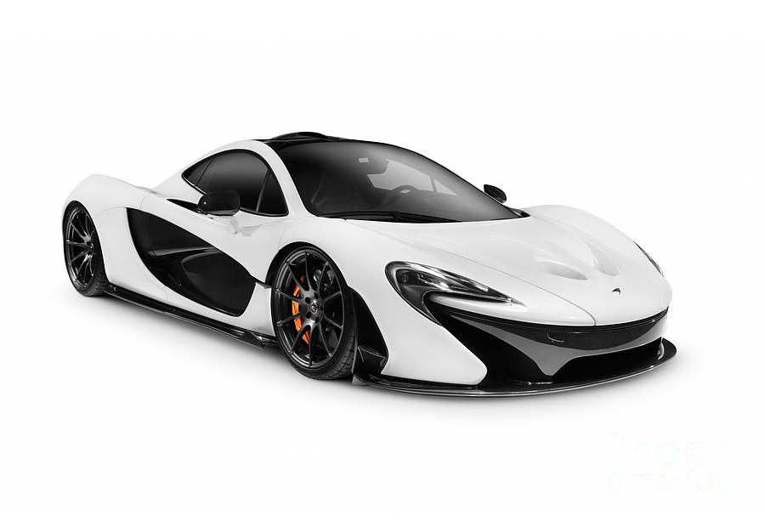
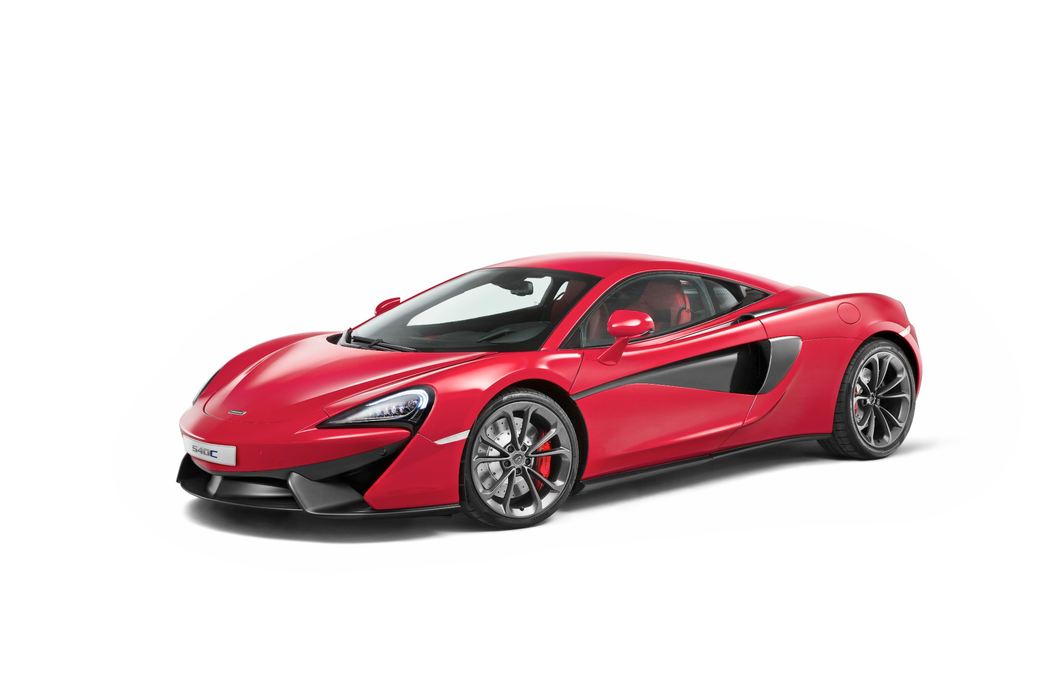
CSE 586 Project:
SimSiam Car Logo Identification
Dylan Knowles and Akash Kumar

Slide 2
Project Description
Project description: Take an existing SimSiam network and apply transfer learning to create and train an unsupervised neural network for the purpose of car brand logo identification.
Goal: To get a logo classification accuracy of at least 80%.
Dataset: Car brand logos dataset containing 2,913 images of 8 car logos. Each brand has 300~350 training photos and ~50 test photos.
https://www.kaggle.com/datasets/volkandl/car-brand-logos?resource=download

Slide 3








8 Car Brand Classes

Slide 4
Technical Approach 🛠️
Step 1: Download the SimSiam PyTorch model and code from the original SimSiam paper’s GitHub repo. (https://github.com/facebookresearch/simsiam)
Step 2: Download the car brand logos dataset from Kaggle.
Step 3: Modify main_simsiam.py to work with single GPU or CPU. Since we are doing transfer learning, we freeze all the layers of the network (set requires_grad_ = False) except for the first two layers of the encoder and the last layer of the predictor. We also added our own command line arguments to make it easier to begin training from a saved model checkpoint.
Step 4: In SimSiam, all the images used in training must be positive sample pairs. To ensure this, data augmentation is applied to create a pair of two similar looking images from the same image for each image in the training set.

Slide 5
Technical Approach (continued…) 🛠️
Step 5: Before training our model, we load a model from a saved checkpoint that’s been trained for 100 epochs by the SimSiam authors.
Original hyperparameter defaults:
batch size = 512
Number of data loading workers = 32
Number of epochs = 100
Our defaults:
batch size = 32
Number of data loading workers = 8
Number of epochs = 20
All other hyperparameter defaults such as learning rate (0.05), momentum (0.9) and weight decay (0.0001) were kept the same.

Slide 6
Technical Approach (continued…) 🛠️
Step 6: Run main_simsiam.py to train the model for 20 epochs. We use our own GTX 1070 GPU to speed up training time by 5x - 6x.
Step 7: After training, a checkpoint containing the model’s learned parameters is saved to a .tar file.
Step 8: Modify main_lincls.py to work with single GPU or CPU.
Step 9: Run main_lincls.py to train the linear classifier for 100 epochs. Load the pre-trained SimSiam network and freeze all the layers. Add an FC layer at the end with the same number of output features as the number of classes in the dataset. Train only this last layer.
Step 10: After training the classifier, save the model to a .tar file and review its classification accuracy.

Slide 7

Experiments Performed
Changing the batch size to see the impact on training time and accuracy.
Changing the learning rate…
Fixed vs. unfixed predictor learning rate.
Changing the number of training epochs to see impact on accuracy.
Changing the backbone network. Default: ResNet-50.
Using a similar transfer learning procedure to train a SimSiam network to classify different kinds of brand logos besides just car brands.

Slide 8
Results

Slide 9
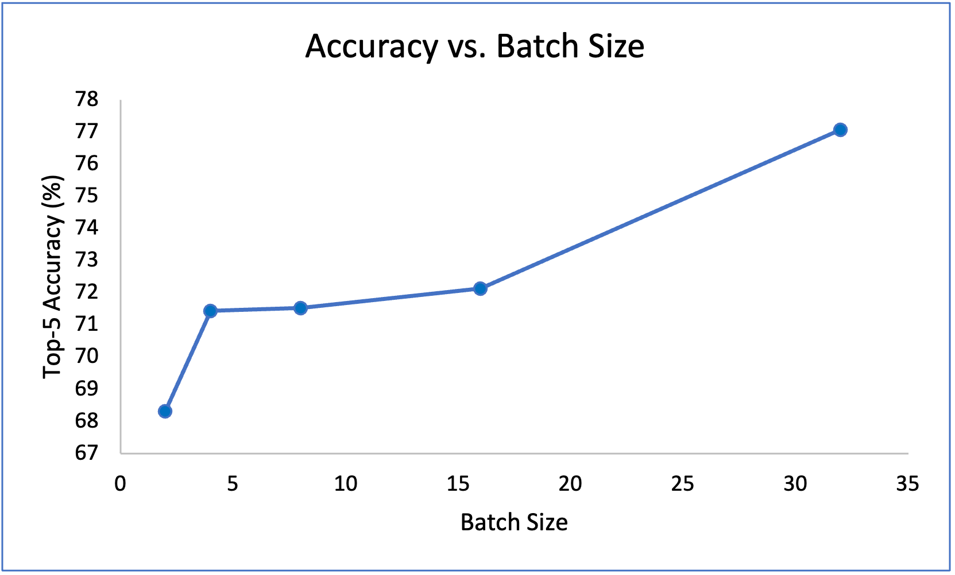

Slide 10
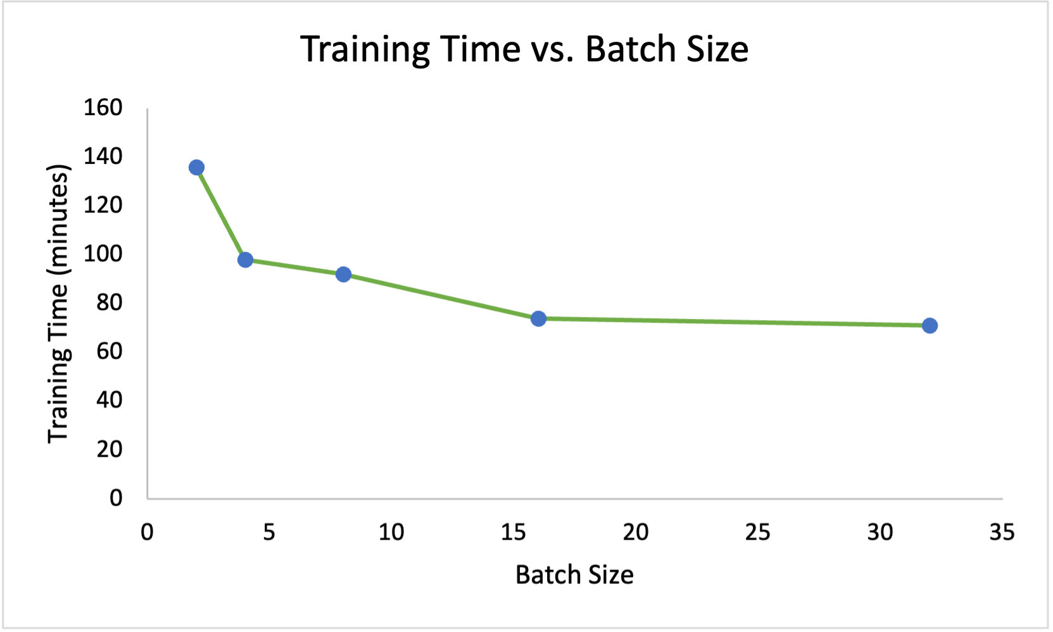

Slide 11
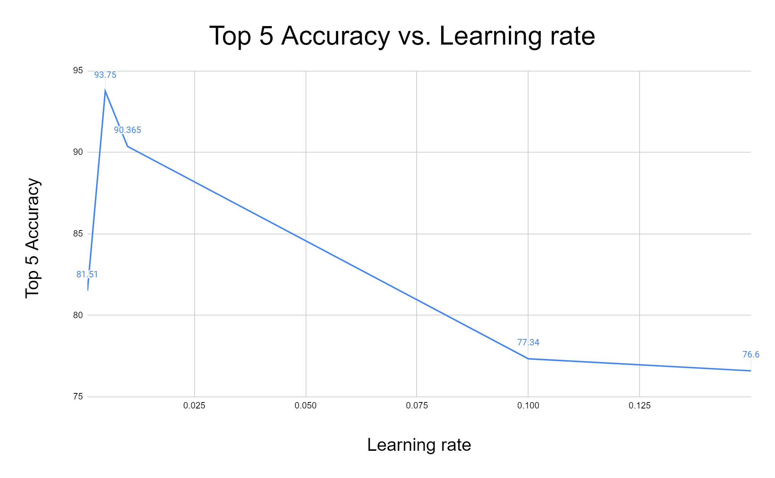
Learning rate experiments
Results based off of top-5 accuracy
Took result from most recent epoch
All other hyper parameters were kept as default
Learning rate did not effect training or classification time.
Ran for about 22 min for training and 1 hr and 22 min

Slide 12
Fixed vs. Unfixed Predictor Learning Rate
Effect on Accuracy:
Note: Only the type of predictor learning rate was changed. All of the other hyperparameters and backbone network were kept the same.
Predictor Learning Rate Type | Top-5 Accuracy (%)
Fixed | 77.34
Unfixed | 93.49

Slide 13
Fixed vs. Unfixed Predictor Learning Rate
Effect on Training Time:
Note: Only the type of predictor learning rate was changed. All of the other hyperparameters and backbone network were kept the same.
Predictor Learning Rate Type | Training Time
Fixed | 1 hrs, 11 mins
Unfixed | 1 hrs, 45 mins

Slide 14
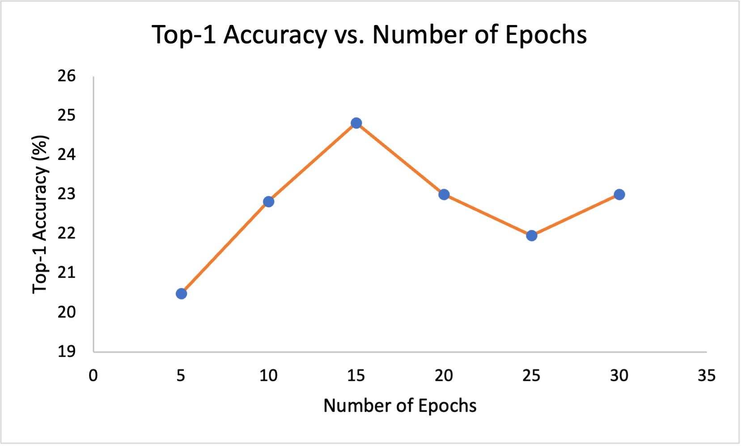

Slide 15
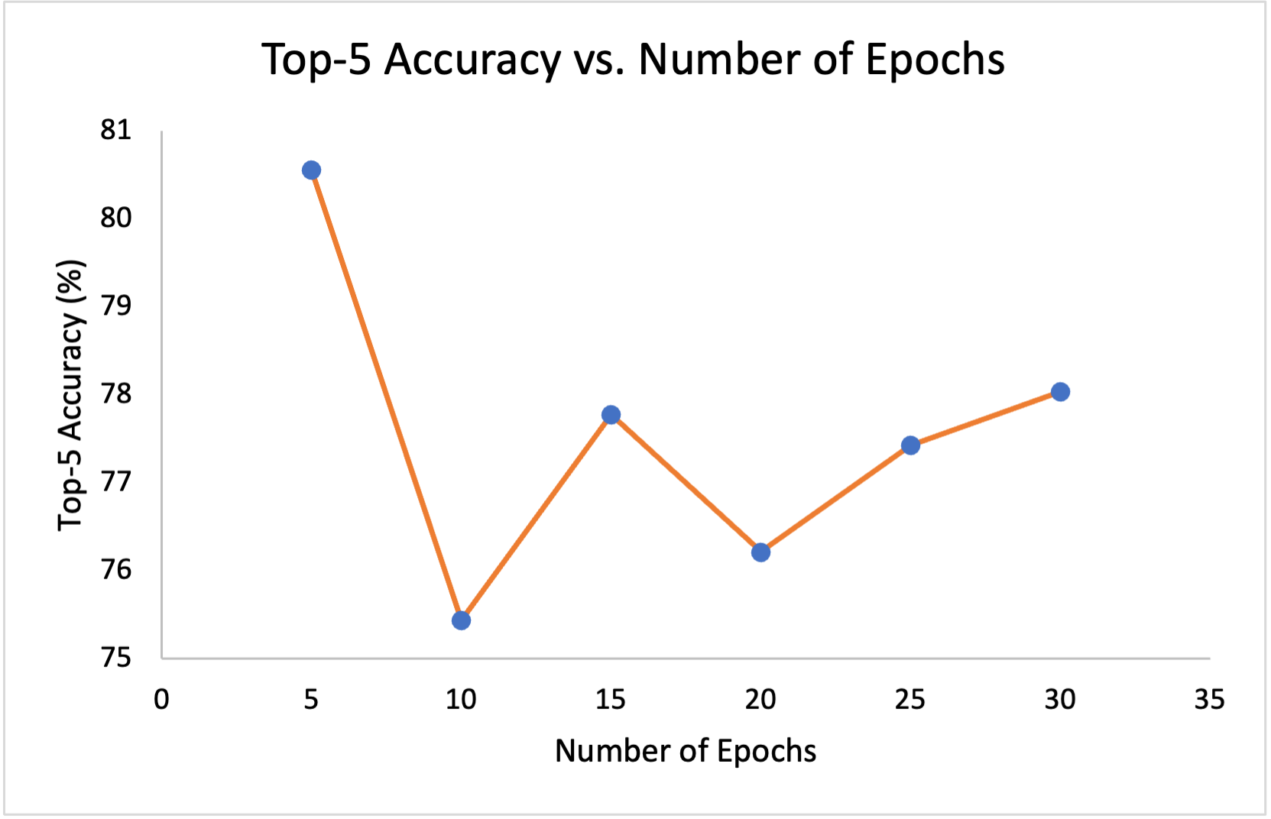

Slide 16
Changing the Backbone Network 🦴
Changed the backbone network from the default ResNet-50 backbone to EfficientNetV2.
ResNet-50 has ~25.6M parameters and EfficientNetV2 (small) has ~21.5M parameters.
Both backbones were pre-trained on ImageNet-1K dataset.
Keeping all default hyperparameters the same and unfixed predictor learning rate, EfficientNetV2 performs slightly better in terms of accuracy.
SimSiam with EfficientNetV2 backbone trained slightly faster than with ResNet-50 backbone (exact time measurements not available).
Notes:
https://pytorch.org/vision/stable/models.html

Slide 17
Changing the Backbone Network 🦴
Backbone Network | Top-5 Accuracy (%)
ResNet-50 | 93.49
EfficientNetV2 (small) | 96.09
Notes:
https://pytorch.org/vision/stable/models.html

Slide 18
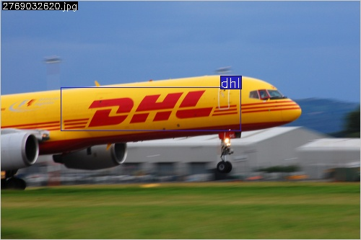
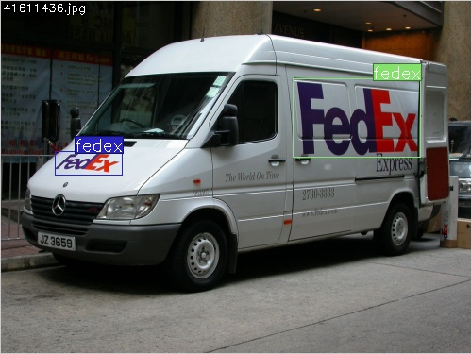
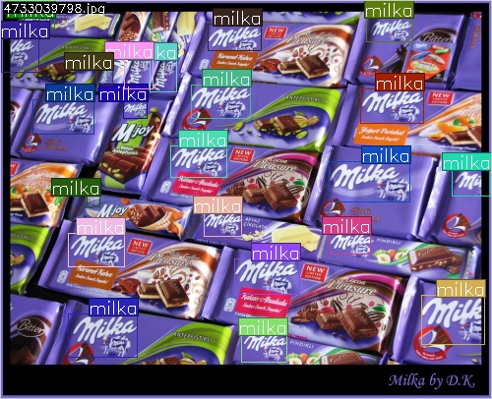
SimSiam on FlickrLogos-32 Dataset
Has a 32 class dataset
8240 total photos
Used 6592 photos (roughly 80%) for training
Used 1648 photos (roughly 20%) for testing
Got 83.456 % top-5 accuracy
All other hyper parameters were kept constant and at default
Notes:
https://www.uni-augsburg.de/en/fakultaet/fai/informatik/prof/mmc/research/datensatze/flickrlogos/

Slide 19
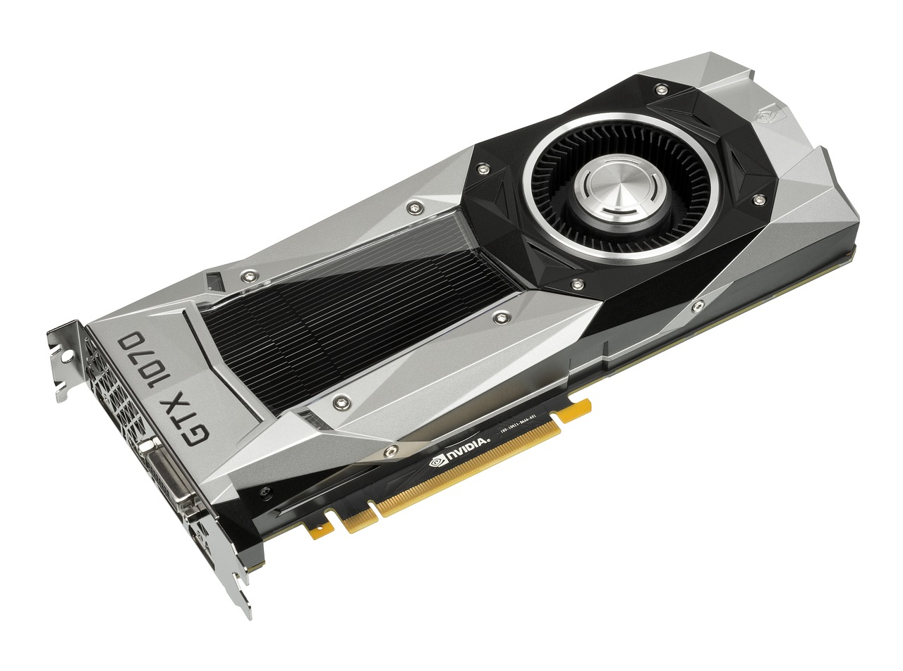
Lessons Learned
SimSiam is a powerful unsupervised learning technique for image classification.
Increasing batch size improves the accuracy and training time up to a point.
Reducing the learning rate results in better accuracy but longer training times.
Changing the backbone network can result in better classification accuracy.
We learned how to use PyTorch and do transfer learning.
We now have a better understanding of how the SimSiam network works.
Check to make sure the hyperparameters are set properly before beginning training. Otherwise time and computations will be wasted.
GPUs are great for accelerating neural network training!

Slide 20
Future Work
Adjust the weight decay hyperparameters to see its impact on accuracy.
Adjust the learning decay.
Try more backbone networks.
Explore different data augmentation methods and compare performance.
Apply repeated transfer learning and compare with direct transfer learning. For example, take a SimSiam network that’s been trained using transfer learning to identify brand logos and apply transfer learning to use this network’s learned parameters to train a network that identifies only car logos (or vice versa).

Slide 21
References
[1] Chen, Xinlei, and Kaiming He. "Exploring simple siamese representation learning." Proceedings of the IEEE/CVF conference on computer vision and pattern recognition. 2021.
[2] Bianco, Simone, et al. "Deep learning for logo recognition." Neurocomputing 245 (2017): 23-30.
[3] Xia, Yizhang, Jing Feng, and Bailing Zhang. "Vehicle Logo Recognition and attributes prediction by multi-task learning with CNN." 2016 12th International Conference on Natural Computation, Fuzzy Systems and Knowledge Discovery (ICNC-FSKD). IEEE, 2016.
[4] Scalable Logo Recognition in Real-World Images Stefan Romberg, Lluis Garcia Pueyo, Rainer Lienhart, Roelof van Zwol ACM International Conference on Multimedia Retrieval 2011 (ICMR11), Trento, April 2011.

